Slide 1
OEE Overall Equipment Effectiveness
DEFINITION & BreakDown

Slide 2
Definition OEE
Overall equipment effectiveness (OEE) is a measure of how well a manufacturing operation is utilized (facilities, time and material) compared to its full potential, during the periods when it is scheduled to run.
It identifies the percentage of manufacturing time that is truly productive.
An OEE of 100% means that only good parts are produced (100% quality), at the maximum speed (100% performance), and without interruption (100% availability).
OEE not only measures, but also shows “hidden” potential improvements.

Slide 3
Effect of OEE implementation
OEE is focused on machine operation, not the operator;
Effect = Quality * Acceptance;
Why do we want to implement OEE?
For whom do we implement OEE?
What will we do with gained machine production time?
produce more in same time;
produce same in less time;
explain necessity;
produce same in same time, smaller lot sizes/batches;
stock reduction.

Slide 4
OEE BreakDown Simplified
OEE = Availability * Performance * Quality
Availability: percentage of scheduled time that the operation is available to operate. Often referred to as Uptime;
Performance: speed at which the Work Center runs as a percentage of its designed speed;
Quality: Good Units produced as a percentage of the Total Units Started. It is commonly referred to as the “first pass yield”. (the number of units coming out of a process divided by the number of units going into that process over a specified period of time. Only good units with no rework or scrap are counted as coming out of an individual process);

Slide 5
Availability
The Availability portion of the OEE Metric represents the percentage of scheduled time that the operation is available to operate;
The Availability Metric is a pure measurement of Uptime that is designed to exclude the effects of Quality and Performance. The losses due to wasted availability are called availability losses;
The ‘availability rate’ indicates the relationship between the time that the machine could theoretically have been in operation (there was ‘demand’) and the time that there was actual output;
Availability = Actual Production Time / Potential Production Time
Potential Production Time= Total Operating Time -/- Not Scheduled Operating Time (factory lights are out);
Actual Production Time: Potential Production Time -/- SUM of:
Unscheduled Idle Time ( Equipment related activities/time executed during Not Scheduled Operating Time (preventive maintenance on Saturday));
Unscheduled Down Time (The equipment is scheduled out of the total operations time, for reasons beyond the scope of the production team)
Line Restraint Time (The equipment cannot generate output because it gets no input from the line, or cannot give its output to the line);
Waiting Time (The machine is not producing output because it has to wait for something (like a setup);
Failure Time (The machine is not having output due to a machine related technical problem);

Slide 6
Performance
The Performance portion of the OEE Metric represents the speed at which the Work Center runs as a percentage of its designed speed;
The Performance Metric is a pure measurement of speed that is designed to exclude the effects of Quality and Availability;
In the performance rate, ‘theoretical output’ is the output that the machine could have made in theory if the machine had operated at maximum speed during the time that it actually operated;
Performance = Actual Output / ( Actual Production Time * Standard Production Speed )
Actual Output = produced units during Actual Production Time;
Standard Production Speed: the theoretical maximum speed (units in time) for a product(group) on the machine. Thus the performance rate never exceeds 100%.
In case of multiple deviating “speeds” see sheets Performance: multiple deviating speeds

Slide 7
Quality
The Quality portion of the OEE Metric represents the Good Units produced as a percentage of the Total Units produced;
The Quality Metric is a pure measurement of Process Yield that is designed to exclude the effects of Availability and Performance;
The relationship between the number of units produced and the number of the units produced that meet the specification is the ‘quality rate’.
Quality = ( Actual Output -/- Rejected Output ) / Actual Output
Actual Output = produced units during Actual Production Time;
Rejected Output = produced units during Actual Production Time that do not meet the specifications:
Scrap;
Rework.
In case of multiple deviating “speeds” see sheets Quality: multiple deviating speeds

Slide 8
OEE (%)
Availability * Performance * Quality
Availability (%)
Performance (%)
Quality
(%)
Actual Production Time
Potential Production Time
Actual Output
( Actual Production Time * Standard Production Speed)
(Actual Output -/- Rejected Output )
Actual Output
Actual Production Time (time)
Actual Output
(units)
Rejected Output
(units)
Potential Production Time
-/- Unscheduled Idle Time
-/- Unscheduled Down Time
-/- Line Restraint Time
-/- Waiting Time
-/- Failure Time
Standard Production Speed
(units/time)
Scrap + Rework
Potential Production Time
(time)
Failure Time (time)
Scrap
(units)
Rework
(units)
Total Time -/-
Scheduled Down Time
Waiting Time (time)
Line Restraint Time (time)
Total Operating Time
(time)
Not Scheduled Operating Time (time)
UnScheduled Down Time (time)
UnScheduled Idle Time
(time)

Slide 9
Performance: multiple deviating speeds (I)
Possibility 1: Performance Calculation quantity based;
Performance = Actual Output / Theoretical Output;
Key Item: Standard Production Speed: Units/Time;
Performance = ( Actual Output 1 + Actual Output 2 + … + Actual Output n ) /
[ ( Actual Production Time 1 * Standard Production Speed 1) +
( Actual Production Time 2 * Standard Production Speed 2) +
……..
( Actual Production Time n * Standard Production Speed n) ]

Slide 10
Performance: multiple deviating speeds (II)
Possibility 2: Performance Calculation time based:
Performance = Theoretical Production Time / Actual Production Time;
Key Item: Standard Cycle Time: Time/Unit (is inversed “standard production speed”);
Performance = [ Actual Output 1 * Standard Cycle Time 1 +
Actual Output 2 * Standard Cycle Time 2 +
… +
Actual Output n * Standard Cycle Time n ] /
( Actual Production Time 1 + Actual Production Time 2 + …….. + Actual Production Time n)

Slide 11
Performance: multiple deviating speeds (III)
Calculating performance per order (specific standard production speed/cycle time) the result will be the same;
Calculating performance over all orders, results will be different;
Especially when significant deviations in standard production speeds exist;
Conform Nakajima (founder of OEE), using the time-based method will come closer to the original goal of OEE;
However, operators communicate in quantities and calculating in quantities is easier to understand. Hence quantity-based calculation is also acceptable.

Slide 12
Quality: multiple deviating speeds (I)
Possibility 1: Quality Calculation quantity based;
Quality = (Actual Output -/- Rejected Output ) / Actual Output;
Quality = [ ( Actual Output 1 -/- Rejected Output 1)
+ ( Actual Output 2 -/- Rejected Output 2)
+ …
+ ( Actual Output n -/- Rejected Output n) ]
/
( Actual Output 1 + Actual Output 2 + …….. + Actual Output n)

Slide 13
Quality: multiple deviating speeds (II)
Possibility 2: Quality Calculation time based:
Quality = [ Standard Cycle Time * (Actual Output -/- Rejected Output ) ] /
( Standard Cycle Time * Actual Output );
Key Item: Standard Cycle Time: Time/Unit (is inversed “standard production speed”);
Quality = [ {Standard Cycle Time 1 * ( Actual Output 1 -/- Rejected Output 1) }
+ {Standard Cycle Time 2 * ( Actual Output 2 -/- Rejected Output 2) }
+ …
+ {Standard Cycle Time n * ( Actual Output n -/- Rejected Output n) } ]
/
[ ( Standard Cycle Time 1 * Actual Output 1 ) + ( Standard Cycle Time 2 * Actual Output 2 )
+ …….. + ( Standard Cycle Time n * Actual Output n) ]

Slide 14
Quality: multiple deviating speeds (III)
Calculating quality per order (specific standard production speed/cycle time) the result will be the same;
Calculating quality over all orders, results will be different;
Especially when significant deviations in standard production speeds exist;
Conform Nakajima (founder of OEE), using the time-based method will come closer to the original goal of OEE;
However, operators communicate in quantities and calculating in quantities is easier to understand. Hence quantity-based calculation is also acceptable.

Slide 15
OEE (%)
Availability * Performance * Quality
Availability (%)
Performance (%)
Quality
(%)
Actual Production Time
Potential Production Time
( Actual Output * Standard Cycle Time ) Actual Production Time
( Standard Cycle Time * (Actual Output -/- Rejected Output ))
( Standard Cycle Time * Actual Output )
Actual Production Time (time)
Actual Output
(units)
Rejected Output
(units)
Potential Production Time
-/- Unscheduled Idle Time
-/- Unscheduled Down Time
-/- Line Restraint Time
-/- Waiting Time
-/- Failure Time
Scrap + Rework
Potential Production Time
(time)
Standard Cycle Time
(time/unit)
Failure Time (time)
Scrap
(units)
Rework
(units)
Total Time -/-
Scheduled Down Time
Waiting Time (time)
Line Restraint Time (time)
Total Operating Time
(time)
Not Scheduled Operating Time (time)
UnScheduled Down Time (time)
UnScheduled Idle Time
(time)

Slide 16
Used documentation
https://www.oeeindustrystandard.org/v2011/nl
https://www.oeefoundation.org/
http://www.oeestandard.com/eng/eng_4_definition.html
https://en.wikipedia.org/wiki/Overall_equipment_effectiveness#cite_note-6
https://www.oee.com/faq.html
OEE for Operators and Managers (in Dutch), Bert Teeuwen and Twan Kersten, Yokoten, 2013.

Slide 17
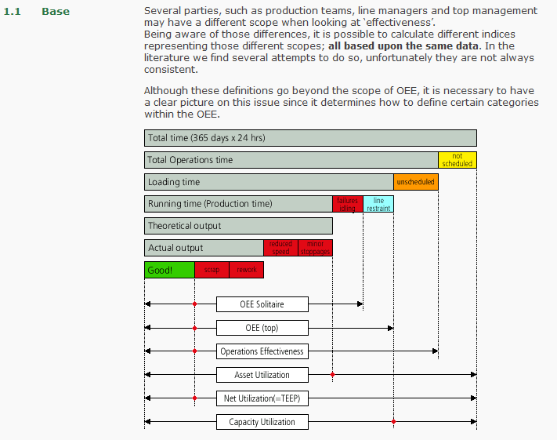

Slide 18
